Slide 1
Consumer Churn Program
Framework and capabilities

Slide 2
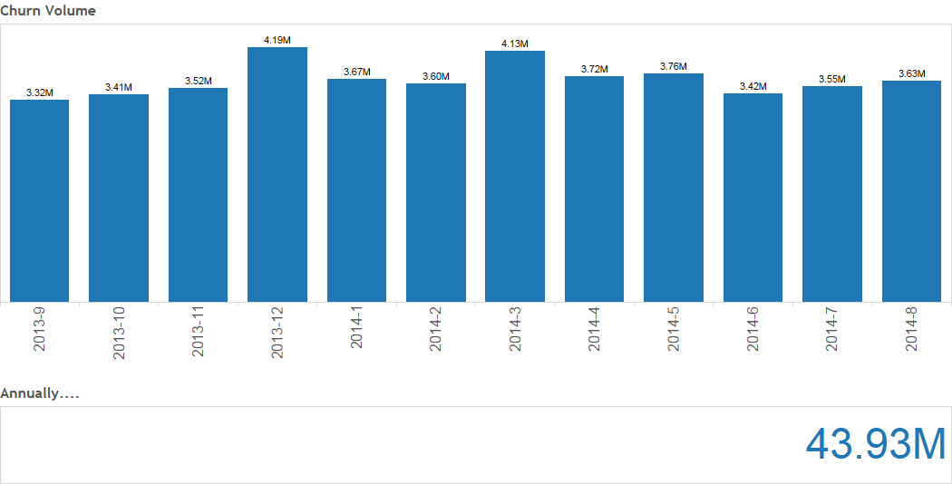
Churn Program
Why Churn?

Slide 3
Our consumer base
From 30,000 feet up
Notes:
We have consumers that transact very infrequently but regularly, so, there’s no cut off point, where we can say this is the churn period. It is a slow, constant decay

Slide 4
Before and after…
The thinking around churn
Wait, the consumer hasn’t churned yet, we’ll do xx after they churn
Churn happens when we found out
Let’s assign a probability every day and figure out today, if someone’s going to churn next year. It’s ok if you’re not super accurate
A consumer churned on the day of their last transaction, not when we found out, but, when they did their last transaction (probably)

Slide 5
High-level idea of audience
How will our internal customers use the product
Churn Model Output
Executive
Marketing
Analysts
Consistency (can’t change 12 month churn to 45.87 days, or refer to churn as “brief hiatus”)
Aggregates and segments
May be related but different from what drives action for other personas, so, code needs to be written
Easy to put into PowerPoint, email, Excel
Moderately fast tool to size population
Must have filters on region and country
Actual population is much smaller
Test/control clarity and size estimator
Data, documentation

Slide 6
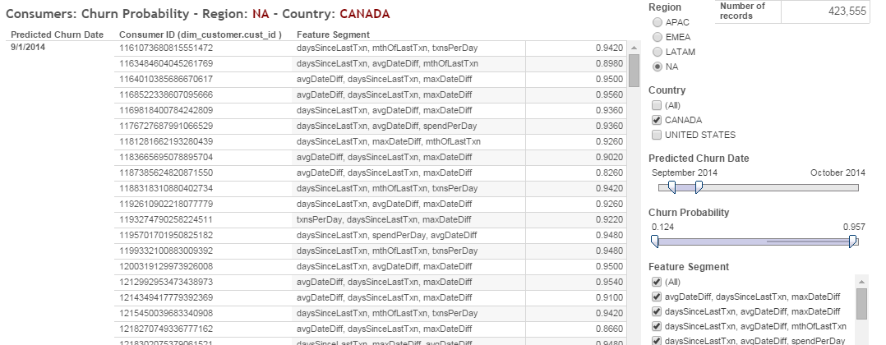
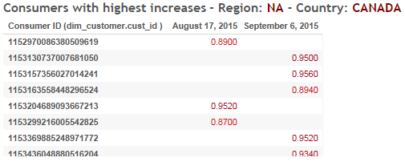
Rough idea of end product
What do we think will resonate with our internal customers

Slide 7
Predictive Modeling Exercise
Mission Statement to Data Product
Exploratory Data Analysis
Modeling
Production
Feature identification and reduction
SQL, Pig, Python, R, SK Learn
Transaction variables - v. important; FPTI variables - moderately important; Demographic – meh
Automation is critical, saves time in the long run
Optimize SQL or MapReduce now, don’t wait until production
JDBC >> ODBC
Further feature reduction, fitting, tuning, validation
R, Python (SK Learn)
Ensemble models rock! Validate sample size, go multi processing early, QC your data
Use 80,10 and 10 as training, testing and validation sets and n_folds
AUC to set threshold
Focus on Confusion matrix variables like accuracy, in class error, recall,.. to compare models
MVP for time/accuracy and iterate
R, Python, SK learn, C3, HTML, Tableau, FEXP, BTEQ
Scale with C3 and a Unix cluster management tool
HTML wrapper helps keep things organized and version controlled
I/O is time consuming - FEXP on a DT ETL Box is super fast

